Slide 1
MEMENTO DESIGN PATTERN
By:- Deepak Gupta

Slide 2
What is MEMENTO Design Pattern?
This design pattern is classified as a behavioral design pattern.
The behavioral design patterns describe how a group of objects cooperate to perform a task that no single object can carry out.
This design pattern is used to restore the state of an object to a previous state. It allows to capture and externalize an object’s internal state so that this can be used while restoring, without violating encapsulation.

Slide 3
MOTIVATION
Sometimes it is necessary to record the internal state of an object
This is required when implementing checkpoints and undo certain mechanisms.
Exposing this internal state leads to violation of encapsulation which in turn leads to compromising the application’s reliability and extensibility.
A memento is an object that stores a snapshot of the internal state of another object - the memento’s originator.
The undo mechanism will request memento from the originator when it needs to checkpoint the originator’s state.
The originator initializes the memento with information that characterizes its current state.
Only originator can store and retrieve information from the memento. For other objects, the memento is “opaque”.

Slide 4
PARTICIPANTS
Memento
stores internal state of the Originator object. The memento may store as much or as little of the originator's internal state as necessary at its originator's discretion.
it’s just a POJO (Plain Old Java Object).
Originator
creates a memento containing a snapshot of its current internal state.
uses the memento to restore the internal state.
only the originator that produced the memento would be permitted to access the memento's internal state.
Caretaker
the object that keeps track of multiple memento. Like maintaining savepoints.
never operates on or examines the contents of a memento.

Slide 5
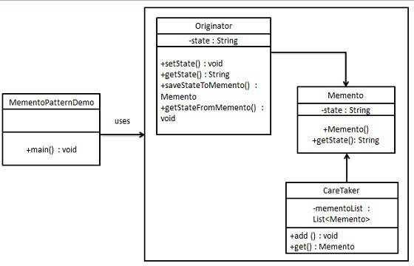
STRUCTURE

Slide 6
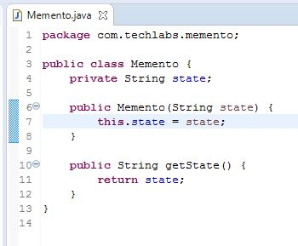
IMPLEMENTATION
MEMENTO CLASS
Encapsulates the internal state of Originator.
Has a constructor and state getter method.

Slide 7
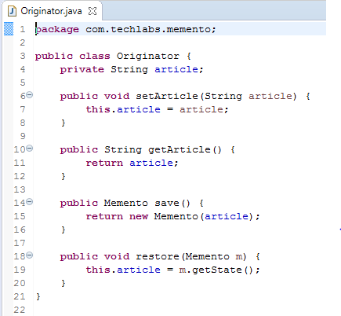
IMPLEMENTATION
ORIGINATOR CLASS
Maintains the current state.
Has state getter and setter method.
Converts current state into Memento object to be stored in Caretaker.
Loads state from target Memento into current state.

Slide 8
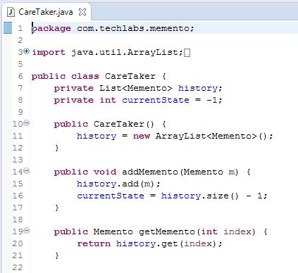
IMPLEMENTATION
CARETAKER CLASS
Maintains a list of mementos.
Adds a memento into the list.
Get a memento from the list.

Slide 9
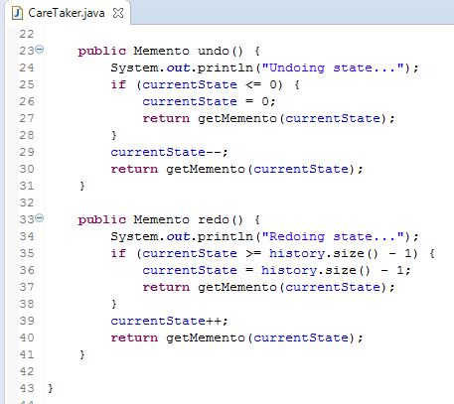
IMPLEMENTATION
CARETAKER CLASS (contd..)
Contains UNDO and REDO methods to go forward and backward in the state timeline.

Slide 10
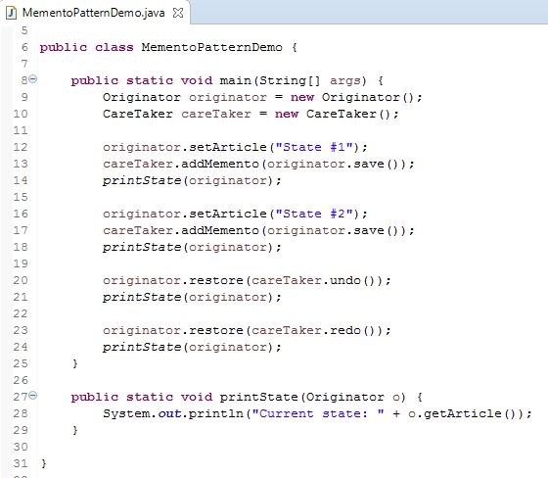
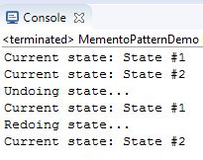
EXECUTION
OUTPUT

Slide 11
Some Known Uses of MEMENTO
DATABASE TRANSACTIONS
Transactions are operations on the database that occur in an atomic, consistent, isolated and durable fashion.
A transaction consists of many operation, if one operation fails, whole transaction should fail too, and the changes should be reverted.
After each operation a new Memento is created, saving the changes made using it. When an operation is failed, these Memento is used to revert back the changes made.
Fresh caretaker can be used for each transaction, number of operations dynamically limit the number of mementos.

Slide 12

Some Known Uses of MEMENTO
UNDO and REDO
Used to rectify mistakes.
State contains data of the current state of the application.
The context of application is saved as state.

Slide 13
PROS and CONS of MEMENTO
PROS
Provides a way of recording the internal state of an object in a separate object without violating encapsulation.
Eliminates the need of multiple creation of the same object(redundancy) for the sole purpose of saving its state.
Provides flexibility of going forward and backward in state timeline.
CONS
Saving and restoring the state may be time consuming.
If Originator object is very huge then Memento object size will also be huge and thus use a lot of memory.

Slide 14
THANK YOU..!!

